Slide 1
Introduction to Python

Slide 2
About Python
Python is a general purpose programming language that is often applied in scripting roles.
So, Python is programming language as well as scripting language.
Python is also called as Interpreted language
Python is a cross-platform programming language, which means that it can run on multiple platforms like Windows, macOS, Linux, and has even been ported to the Java and .NET virtual machines. It is free and open-source.
Even though most of today's Linux and Mac have Python pre-installed in it, the version might be out-of-date. So, it is always a good idea to install the most current version.

Slide 3
Usage of Python
Python is a general purpose, open source, high-level programming language and also provides number of libraries and frameworks. Python has gained popularity because of its simplicity, easy syntax and user-friendly environment. The usage of Python as follows.
Desktop Applications
Web Applications
Data Science
Artificial Intelligence
Machine Learning
Scientific Computing
Robotics
Internet of Things (IoT)
Gaming
Data Analysis and Pre-processing

Slide 4
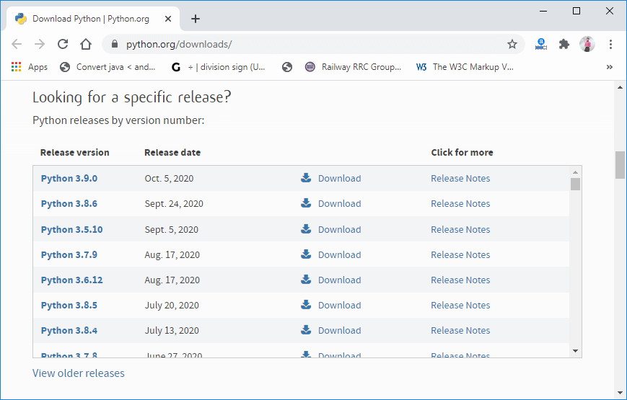
Install Python Separately
Visit the link https://www.python.org/downloads/ to download the latest release of Python. In this process, we will install Python 3.8.6 on our Windows operating system.
Step - 1: Select the Python's version to download.

Slide 5
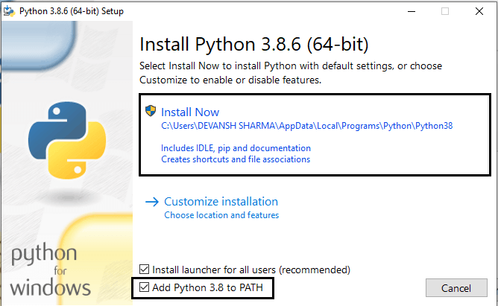
Step - 2: Click on the Install Now
Double-click the executable file, which is downloaded; the following window will open. Select Customize installation and proceed. Click on the Add Path check box, it will set the Python path automatically.
We can also click on the customize installation to choose desired location and features. Other important thing is install launcher for the all user must be checked.

Slide 6
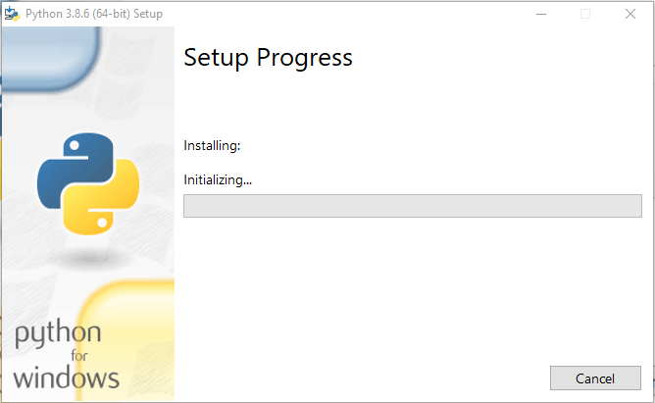
Step - 3 Installation in Process

Slide 7
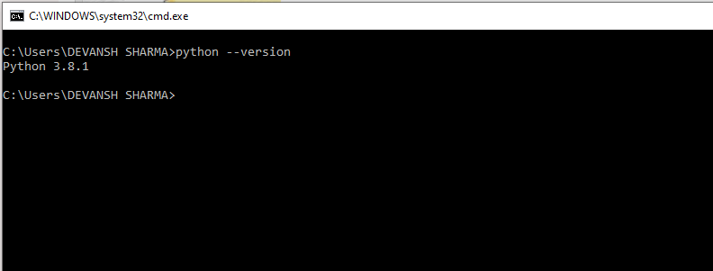
Now, try to run python on the command prompt. Type the command python -version in case of python3.

Slide 8
The Anaconda Distribution of Python
When you download the Anaconda distribution of Python from Anaconda.com, you get a Python Interpreter, the Anaconda Prompt (a command line program), Spyder (a code editor) and about 600 extra Python modules that aren't included in the Python Standard Library. The Anaconda distribution of Python also includes a program called Anaconda Navigator that allows you to launch Jupyter notebooks quickly.

Slide 9
Installing Anaconda on Windows
Visit Anaconda.com/downloads
Select Windows
Download the .exe installer
Open and run the .exe installer
Open the Anaconda Prompt and run some Python code

Slide 10


Slide 11

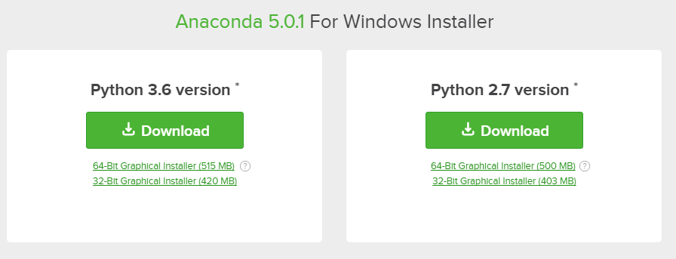
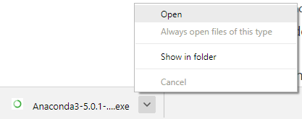

Slide 12
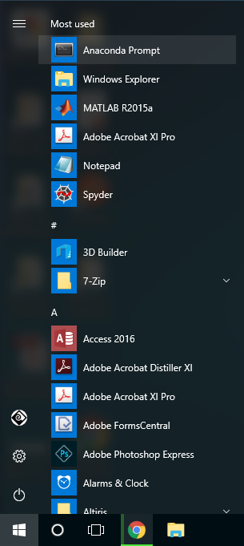
After the installation of Anaconda is complete, you can go to the Windows start menu and select the Anaconda Prompt.

Slide 13
Run Python in Immediate mode
Once Python is installed, typing python in the command line will invoke the interpreter in immediate mode. We can directly type in Python code, and press Enter to get the output.
Try typing in 1 + 1 and press enter. We get 2 as the output. This prompt can be used as a calculator. To exit this mode, type quit() and press enter.

Slide 14
Run Python in the Integrated Development Environment (IDE)
We just need to save it with the .py extension. But using an IDE can make our life a lot easier. IDE is a piece of software that provides useful features like code hinting, syntax highlighting and checking, file explorers, etc. to the programmer for application development.
By the way, when you install Python, an IDE named IDLE is also installed. You can use it to run Python on your computer. It's a decent IDE for beginners.

Slide 15
Python IDE
IDLE
PyCharm
Visual Studio Code
Spyder
Thonny
Jupyter Notebook

Slide 16
Python vs java code
public class HelloWorld {
public static void main(String[] args){
// Prints "Hello, World" to the terminal window.
System.out.println("Hello World");
}
}
print("Hello World")

Slide 17
Basics of Python
Unit -- 2

Slide 18
Table of contents
Keywords and Identifiers
Python Variables
Python Data Types
Python Operators
Python Input, Output and Import
Namespaces and Scope

Slide 19
Keywords and Identifiers
Python Keywords
Keywords are the reserved words in Python.
We cannot use a keyword as a variable name, function name or any other identifier. They are used to define the syntax and structure of the Python language.
In Python, keywords are case sensitive.
There are 35 keywords in Python 3.7. This number can vary slightly over the course of time.
All the keywords except True, False and None are in lowercase and they must be written as they are. The list of all the keywords is given below.
help("keywords")

Slide 20
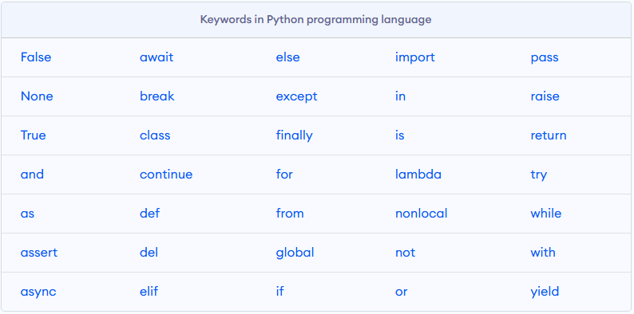
Keywords

Slide 21
Python Identifiers
An identifier is a name given to entities like class, functions, variables, etc. It helps to differentiate one entity from another.
Rules for writing identifiers
here are some rules for writing Identifiers. But first you must know Python is case sensitive. That means Name and name are two different identifiers in Python. Here are some rules for writing Identifiers in python.
Identifiers can be a combination of letters in lowercase (a to z) or uppercase (A to Z) or digits (0 to 9) or an underscore _. Names like myClass, var_1 and print_this_to_screen, all are valid example.
An identifier cannot start with a digit. 1variable is invalid, but variable1 is a valid name.
Keywords cannot be used as identifiers. e.g. global = 1
We cannot use special symbols like !, @, #, $, % etc. in our identifier. e.g. a@ = 0
An identifier can be of any length.

Slide 22
Python Variables
A variable is a named location used to store data in the memory. It is helpful to think of variables as a container that holds data that can be changed later in the program. For example, number = 10
website = "apple.com"
print(website)
Python is a type-inferred language, so you don't have to explicitly define the variable type. It automatically knows that apple.com is a string and declares the website variable as a string.
Note: In Python, we don't actually assign values to the variables. Instead, Python gives the reference of the object(value) to the variable.

Slide 23
Assigning multiple values to multiple variables
A = 10
a, b, c = 5, 3.2, "Hello"
print (a)
print (b)
print (c)
x = y = z = "same"
print (x)
print (y)
print (z)

Slide 24
Python Data Types
Data types are the classification or categorization of data items. It represents the kind of value that tells what operations can be performed on a particular data. Since everything is an object in Python programming, data types are actually classes and variables are instance (object) of these classes.
Following are the standard or built-in data type of Python:
Numeric
Sequence Type
Boolean
Set
Dictionary

Slide 25
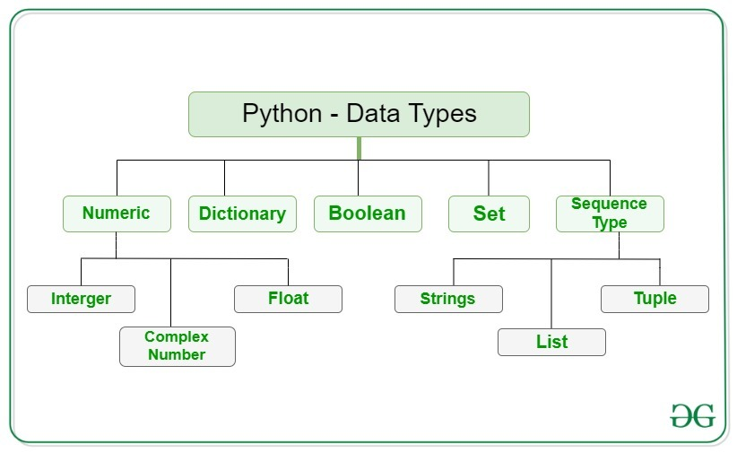
Python Data Types

Slide 26
Python Numeric
In Python, numeric data type represent the data which has numeric value. Numeric value can be integer, floating number or even complex numbers. These values are defined as int, float and complex class in Python.
Integers – This value is represented by int class. It contains positive or negative whole numbers (without fraction or decimal). In Python there is no limit to how long an integer value can be.
Float – This value is represented by float class. It is a real number with floating point representation. It is specified by a decimal point. Optionally, the character e or E followed by a positive or negative integer may be appended to specify scientific notation.
Complex Numbers – Complex number is represented by complex class. It is specified as (real part) + (imaginary part)j. For example – 2+3j

Slide 27
Python Numeric
We can use the type() function to know which class a variable or a value belongs to. Similarly, the isinstance() function is used to check if an object belongs to a particular class.
a = 5
print(a, "is of type", type(a))
a = 2.0
print(a, "is of type", type(a))
a = 1+2j
print(a, "is complex number?", isinstance(a,complex))

Slide 28
Python Numeric
Integers can be of any length, it is only limited by the memory available.
A floating-point number is accurate up to 15 decimal places. Integer and floating points are separated by decimal points. 1 is an integer, 1.0 is a floating-point number.
Complex numbers are written in the form, x + yj, where x is the real part and y is the imaginary part. Here are some examples.
a = 1234567890123456789
a
1234567890123456789
b = 0.1234567890123456789
b
0.12345678901234568
c = 1+2j
c
(1+2j)

Slide 29
Sequence Type
In Python, sequence is the ordered collection of similar or different data types. Sequences allows to store multiple values in an organized and efficient fashion. There are several sequence types in Python –
String
List
Tuple

Slide 30
1) String
In Python, Strings are arrays of bytes representing Unicode characters. A string is a collection of one or more characters put in a single quote, double-quote or triple quote. In python there is no character data type, a character is a string of length one. It is represented by str class.

Slide 31
Examples
String1 = 'Welcome to the Py World'
print("String with the use of Single Quotes: ")
print(String1)
String1 = "I'm a Python"
print("\nString with the use of Double Quotes: ")
print(String1)
print(type(String1))
String1 = '''I'm a Python and I live in a world of “Py”'''
print("\nString with the use of Triple Quotes: ")
print(String1)
print(type(String1))
String1 = ‘’’Python
For
Life’’’
print("\nCreating a multiline String: ")
print(String1)

Slide 32
Accessing elements of String
In Python, individual characters of a String can be accessed by using the method of Indexing. Indexing allows negative address references to access characters from the back of the String, e.g. -1 refers to the last character, -2 refers to the second last character and so on.

Slide 33
Example
String1 = “PythonForLearners"
print("Initial String: ")
print(String1)
# Printing First character
print("\nFirst character of String is: ")
print(String1[0]) --- P
print(String1[5]) --- n
# Printing Last character
print("\nLast character of String is: ")
print(String1[-1]) ---- s

Slide 34
2) List
Lists are just like the arrays, declared in other languages which is a ordered collection of data. It is very flexible as the items in a list do not need to be of the same type.

Slide 35
List = [ ]
print("Intial blank List: ")
print(List)
# Creating a List with the use of a String
List = [‘PythonForLearners ‘]
print("\nList with the use of String: ")
print(List)
# Creating a List with
# the use of multiple values
List = [“Python", "For", “Learners"]
print("\nList containing multiple values: ")
print(List[0])
print(List[2])
# Creating a Multi-Dimensional List
# (By Nesting a list inside a List)
List = [[“Python", "For"], [‘Learners ']]
print("\nMulti-Dimensional List: ")
print(List)

Slide 36
Accessing elements of List
In order to access the list items refer to the index number. Use the index operator [ ] to access an item in a list. In Python, negative sequence indexes represent positions from the end of the array. Instead of having to compute the offset as in List[len(List)-3], it is enough to just write List[-3]. Negative indexing means beginning from the end, -1 refers to the last item, -2 refers to the second-last item, etc.

Slide 37
List = [“Python", "For", “Learners"]
# accessing a element from the list using index number
print("Accessing element from the list")
print(List[0])
print(List[2])
# accessing a element using
# negative indexing
print("Accessing element using negative indexing")
# print the last element of list
print(List[-1])
# print the third last element of list
print(List[-3])

Slide 38
3) Tuple
Just like list, tuple is also an ordered collection of Python objects. The only difference between tuples and list is that tuples are immutable i.e. tuples cannot be modified after it is created. It is represented by tuple class.
Creating Tuple
In Python, tuples are created by placing a sequence of values separated by ‘comma’ with or without the use of parentheses for grouping of the data sequence. Tuples can contain any number of elements and of any data type (like strings, integers, list, etc.).
Note: Tuples can also be created with a single element, but it is a bit tricky. Having one element in the parentheses is not sufficient, there must be a trailing ‘comma’ to make it a tuple.

Slide 39
# Creating an empty tuple
Tuple1 = ( )
print("Initial empty Tuple: ")
print (Tuple1)
# Creating a Tuple with the use of Strings
Tuple1 = (‘Python', 'For')
print("\nTuple with the use of String: ")
print(Tuple1)
# Creating a Tuple with the use of list
list1 = [1, 2, 4, 5, 6]
print("\nTuple using List: ")
print(tuple(list1))
# Creating a Tuple with the use of built-in function
Tuple1 = tuple(‘Python')
print("\nTuple with the use of function: ")
print(Tuple1)
# Creating a Tuple with nested tuples
Tuple1 = (0, 1, 2, 3)
Tuple2 = ('python', ‘For')
Tuple3 = (Tuple1, Tuple2)
print("\nTuple with nested tuples: ")
print(Tuple3)

Slide 40
Accessing elements of Tuple
In order to access the tuple items refer to the index number. Use the index operator [ ] to access an item in a tuple. The index must be an integer. Nested tuples are accessed using nested indexing.

Slide 41
tuple1 = tuple([1, 2, 3, 4, 5])
# Accessing element using indexing
print("Frist element of tuple")
print(tuple1[0])
# Accessing element from last
# negative indexing
print("\nLast element of tuple")
print(tuple1[-1])
print("\nThird last element of tuple")
print(tuple1[-3])

Slide 42
List vs tuple
List = [], mutable, needs more space, takes more time
Tuple = (), immutable, less space, less time

Slide 43
Boolean
Boolean objects that are equal to True are truthy (true), and those equal to False are falsy (false). But non-Boolean objects can be evaluated in Boolean context as well and determined to be true or false. It is denoted by the class bool.
print(type(True))
print(type(False))
print(type(true))
Note – True and False with capital ‘T’ and ‘F’ are valid booleans otherwise python will throw an error.

Slide 44
Set
Set is an unordered collection of data type that is iterable, mutable and has no duplicate elements. The order of elements in a set is undefined though it may consist of various elements.
Creating Sets
Sets can be created by using the built-in set() function with an iterable object or a sequence by placing the sequence inside curly braces {}, separated by ‘comma’. Type of elements in a set need not be the same, various mixed-up data type values can also be passed to the set.
[] --- list(),
tuple() – (),
{} – set()

Slide 45
Creating Set
# empty set
print(set())
# from string
print(set('Python'))
# from tuple
print(set(('a', 'e', 'i', 'o', 'u')))
# from list
print(set(['a', 'e', 'i', 'o', 'u']))
# from range
print(set(range(5)))

Slide 46
Creating Sets
# Creating a Set
set1 = set()
print("Intial blank Set: ")
print(set1)
# Creating a Set with the use of a String
set1 = set(“PythonForLearners")
print("\nSet with the use of String: ")
print(set1)
# Creating a Set with the use of a List
set1 = set(["Python", "For", "Learners"])
print("\nSet with the use of List: ")
print(set1)
# Creating a Set with a mixed type of values (Having numbers and strings)
set1 = set([1, 2, ‘Python', 4, 'For', 6, ‘Learners'])
print("\nSet with the use of Mixed Values")
print(set1)

Slide 47
Accessing elements of Sets
Set items cannot be accessed by referring to an index, since sets are unordered the items has no index. But you can loop through the set items using a for loop, or ask if a specified value is present in a set, by using the in keyword.

Slide 48
Dictionary
Dictionary in Python is an unordered collection of data values, used to store data values like a map, which unlike other Data Types that hold only single value as an element, Dictionary holds key:value pair. Key-value is provided in the dictionary to make it more optimized. Each key-value pair in a Dictionary is separated by a colon :, whereas each key is separated by a ‘comma’.
Creating Dictionary
In Python, a Dictionary can be created by placing a sequence of elements within curly {} braces, separated by ‘comma’. Values in a dictionary can be of any data type and can be duplicated, whereas keys can’t be repeated and must be immutable. Dictionary can also be created by the built-in function dict(). An empty dictionary can be created by just placing it to curly braces{}.
Note – Dictionary keys are case sensitive, same name but different cases of Key will be treated distinctly.

Slide 49
Creating Dictionary
# Creating an empty Dictionary
Dict = {}
print("Empty Dictionary: ")
print(Dict)
# Creating a Dictionary with Integer Keys
Dict = {1: 'Python', 2: 'For', 3: ‘Learners'}
print("\nDictionary with the use of Integer Keys: ")
print(Dict)
# Creating a Dictionary with dict() method
Dict = dict({1: 'Python', 2: 'For', 3:‘Learners'})
print("\nDictionary with the use of dict(): ")
print(Dict)
# Creating a Dictionary with each item as a Pair
Dict = dict([(1, 'Python'), (2, 'For')])
print("\nDictionary with each item as a pair: ")
print(Dict)

Slide 50
# Creating a Dictionary with Mixed keys
Dict = {'Name': 'Python', 1: [1, 2, 3, 4]}
print("\nDictionary with the use of Mixed Keys: ")
print(Dict)

Slide 51
Accessing elements of Dictionary
In order to access the items of a dictionary refer to its key name. Key can be used inside square brackets. There is also a method called get() that will also help in accessing the element from a dictionary.
# Creating a Dictionary
Dict = {1: ‘Python', ‘name’: 'For', 3: ‘Learners'}
# accessing a element using key
print("Accessing a element using key:")
print(Dict['name']) -- For
# accessing a element using get() method
print("Accessing a element using get:")
print(Dict.get(3))

Slide 52
Python Operators
Operators are special symbols in Python that carry out arithmetic or logical computation. The value that the operator operates on is called the operand.
For example:
>>> 2+3
5
Here, + is the operator that performs addition. 2 and 3 are the operands and 5 is the output of the operation.

Slide 53
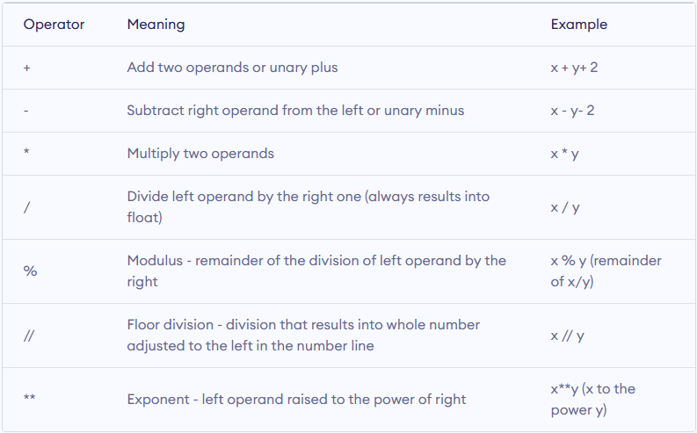
Arithmetic operators
Arithmetic operators are used to perform mathematical operations like addition, subtraction, multiplication, etc.

Slide 55
Example 1: Arithmetic operators in Python
x = 15
y = 4
# Output: x + y = 19
print('x + y =',x+y)
# Output: x - y = 11
print('x - y =',x-y)
# Output: x * y = 60
print('x * y =',x*y)
# Output: x / y = 3.75
print('x / y =',x/y)
# Output: x // y = 3
print('x // y =',x//y)
X%Y
# Output: x ** y = 50625
print('x ** y =',x**y)

Slide 56
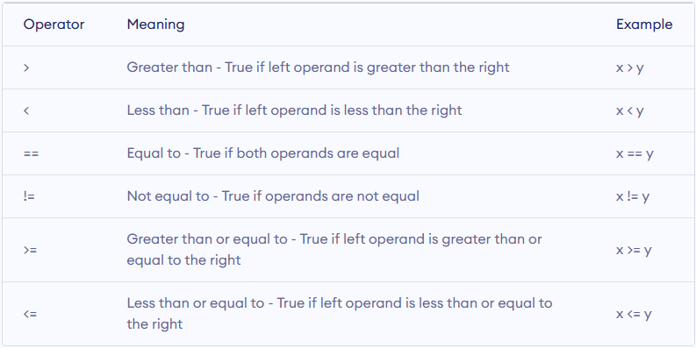
Comparison operators
Comparison operators are used to compare values. It returns either True or False according to the condition.

Slide 57
Example 2: Comparison operators in Python
x = 10
y = 12
# Output: x > y is False
print('x > y is',x>y)
# Output: x < y is True
print('x < y is',x<y)
# Output: x == y is False
print('x == y is',x==y)
# Output: x != y is True
print('x != y is',x!=y)
# Output: x >= y is False
print('x >= y is',x>=y)
# Output: x <= y is True
print('x <= y is',x<=y)

Slide 58
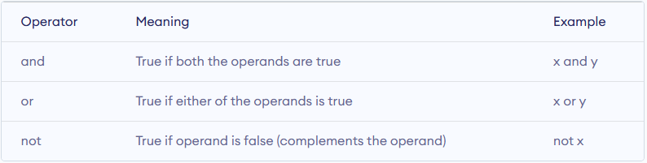
Logical operators
Logical operators are the and, or, not operators.

Slide 59
Example 3: Logical Operators in Python
x = True
y = False
print('x and y is',x and y)
print('x or y is',x or y)
print('not x is',not x)

Slide 60
Bitwise operators
Bitwise operators act on operands as if they were strings of binary digits. They operate bit by bit, hence the name.
For example, 2 is 10 in binary and 7 is 111.

Slide 61
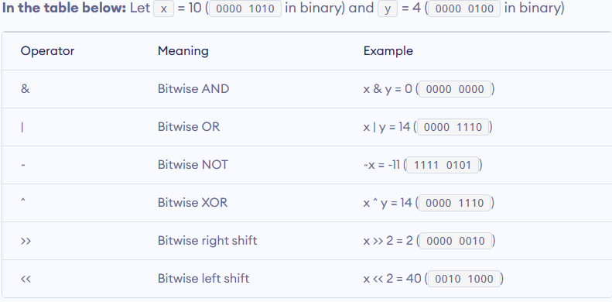
Bitwise operators

Slide 62
X = 0000 0110,
Y = 0000 1000
X&Y = 0000 0000
X|Y = 0000 1110
X^Y = 0000 1110
~X = 1111 1001
x<<1 = 0000 1100
X>>1 = 0000 0011

Slide 63
Assignment operators
Assignment operators are used in Python to assign values to variables.
a = 5 is a simple assignment operator that assigns the value 5 on the right to the variable a on the left.
There are various compound operators in Python like a += 5 that adds to the variable and later assigns the same. It is equivalent to a = a + 5.

Slide 64
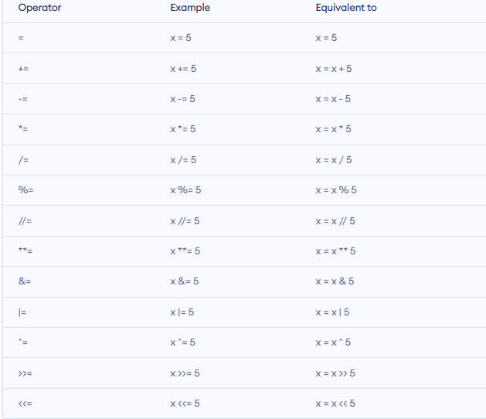

Slide 65
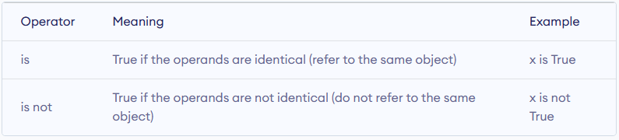
Special operators
Python language offers some special types of operators like the identity operator or the membership operator. They are described below with examples.
Identity operators
is and is not are the identity operators in Python. They are used to check if two values (or variables) are located on the same part of the memory. Two variables that are equal does not imply that they are identical.

Slide 66
Example 4: Identity operators in Python
x1 = 5
y1 = 5
x2 = 'Hello'
y2 = 'Hello'
x3 = [1,2,3]
y3 = [1,2,3]
# Output: False
print(x1 is not y1)
# Output: True
print(x2 is y2)
# Output: False
print(x3 is y3)

Slide 67
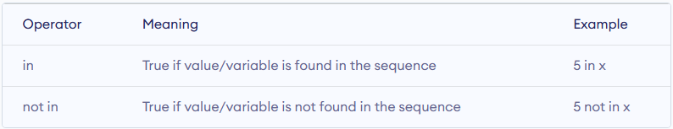
Special operators
Membership operators
in and not in are the membership operators in Python. They are used to test whether a value or variable is found in a sequence (string, list, tuple, set and dictionary).
In a dictionary we can only test for presence of key, not the value.

Slide 68
Example #5: Membership operators in Python
x = 'Hello world'
y = {1:'a',2:'b'}
# Output: True
print('H' in x)
# Output: True
print('hello' not in x)
# Output: True
print(1 in y)
# Output: False
print('a' in y)

Slide 69
Python Input, Output and Import
Python Basics

Slide 70
Input, Output in Python
Python provides numerous built-in functions that are readily available to us at the Python prompt.
Some of the functions like input() and print() are widely used for standard input and output operations respectively. Let us see the output section first.

Slide 71
Python Output Using print() function
We use the print() function to output data to the standard output device (screen)
E.g. 1
print('This sentence is output to the screen')
Output
This sentence is output to the screen
E.g. 2
a = 5
print('The value of a is', a)
Output
The value of a is 5

Slide 72
The actual syntax of the print() function is:
print(*objects, sep=' ', end='\n', file=sys.stdout, flush=False)
Here, objects is the value(s) to be printed.
The sep separator is used between the values. It defaults into a space character.
After all values are printed, end is printed. It defaults into a new line.
The file is the object where the values are printed and its default value is sys.stdout (screen).

Slide 73
print(1, 2, 3, 4)
print(1, 2, 3, 4, sep='*')
print(1, 2, 3, 4, sep='#', end='&')
1 2 3 4
1*2*3*4
1#2#3#4&

Slide 74
Output formatting
Sometimes we would like to format our output to make it look attractive. This can be done by using the str.format() method. This method is visible to any string object.
x = 5; y = 10
print('The value of x is {} and y is {}'.format(x,y))
Output
The value of x is 5 and y is 10
print('I love {0} and {1}'.format('bread','butter'))
print('I love {1} and {0}'.format('bread','butter'))
Output
I love bread and butter
I love butter and bread

Slide 75
print('Hello {name}, {greeting}'.format(greeting = 'Goodmorning', name = 'John'))
Hello John, Goodmorning

Slide 76
Python Input
Up until now, our programs were static. The value of variables was defined or hard coded into the source code.
To allow flexibility, we might want to take the input from the user. In Python, we have the input() function to allow this. The syntax for input() is:
input([prompt])
where prompt is the string we wish to display on the screen. It is optional.
num = input('Enter a number: ')
Enter a number: 10
num
'10'

Slide 77
Namespaces and Scope
Python Basics

Slide 78
Namespaces and Scope
A namespace is a collection of currently defined symbolic names along with information about the object that each name references. You can think of a namespace as a dictionary in which the keys are the object names and the values are the objects themselves. Each key-value pair maps a name to its corresponding object.
In a Python program, there are four types of namespaces:
Built-In
Global
Enclosing
Local

Slide 79
Variable Scope
The scope of a name is the region of a program in which that name has meaning. The interpreter determines this at runtime based on where the name definition occurs and where in the code the name is referenced.
Suppose you refer to the name x in your code, and x exists in several namespaces. How does Python know which one you mean?

Slide 80
Scope
if your code refers to the name x, then Python searches for x in the following namespaces in the order shown:
Local: If you refer to x inside a function, then the interpreter first searches for it in the innermost scope that’s local to that function.
Enclosing: If x isn’t in the local scope but appears in a function that resides inside another function, then the interpreter searches in the enclosing function’s scope.
Global: If neither of the above searches is fruitful, then the interpreter looks in the global scope next.
Built-in: If it can’t find x anywhere else, then the interpreter tries the built-in scope.

Slide 81
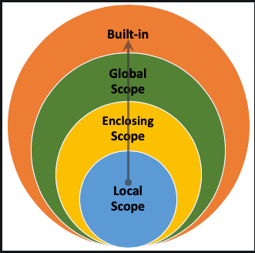
LEGB rule
The interpreter searches for a name from the inside out, looking in the local, enclosing, global, and finally the built-in scope:
If the interpreter doesn’t find the name in any of these locations, then Python raises a NameError exception

Slide 82
Example
x = 'global'
def f():
def g():
print(x)
g()
f()
global
x = 'global'
def f():
x = 'enclosing'
def g():
print(x)
g()
f()
enclosing

Slide 83
Example
x = 'global'
def f():
x = 'enclosing'
def g():
x = 'local'
print(x)
g()
f()
local
def f():
def g():
print(x)
g()
f()
NameError: name 'x' is not defined

Slide 84
Example
def outer_function():
a = 20
def inner_function():
a = 30
print('a =', a)
inner_function()
print('a =', a)
a = 10
outer_function()
print('a =', a)
def outer_function():
global a
a = 20
def inner_function():
global a
a = 30
print('a =', a)
inner_function()
print('a =', a)
a = 10
outer_function()
print('a =', a)

